Slide 1
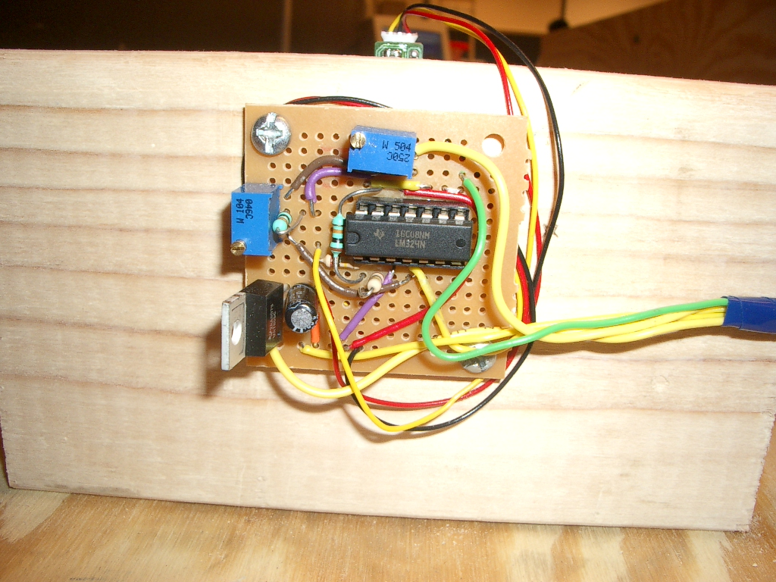
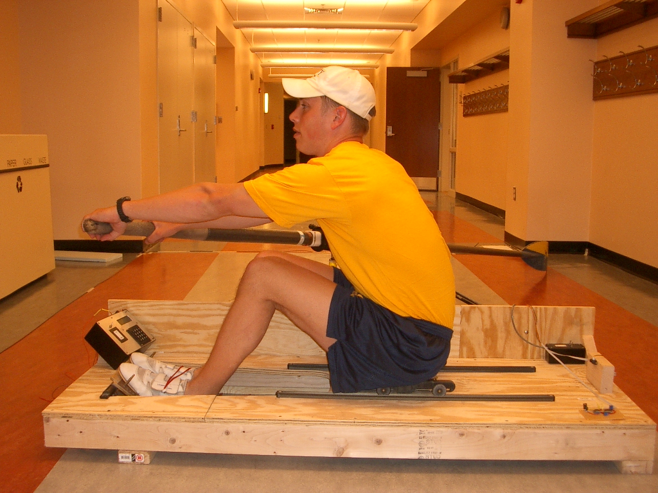
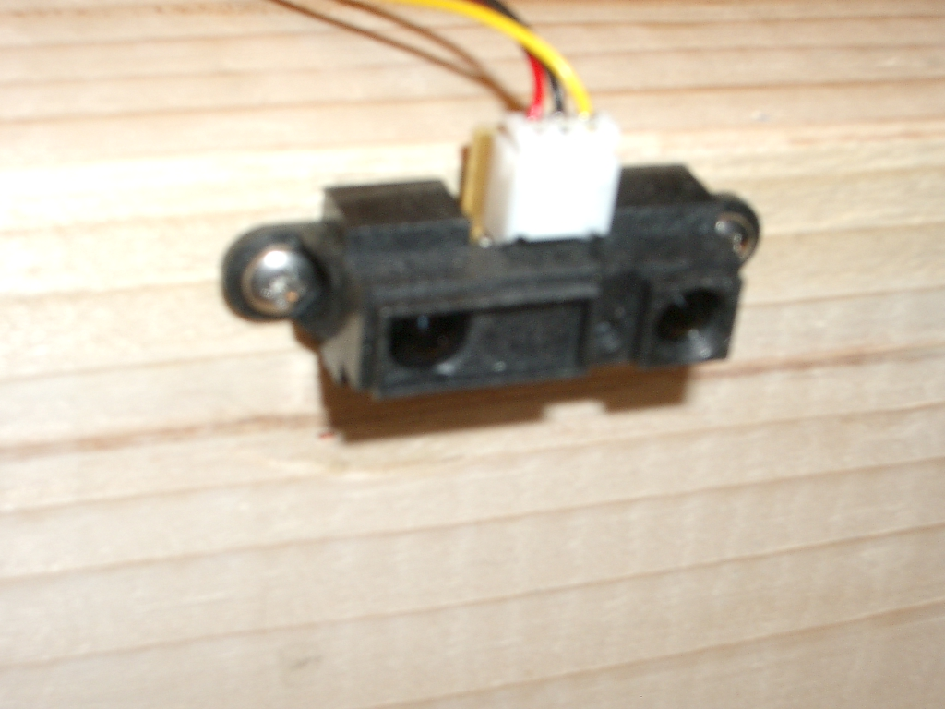
Trial 3 – Successful – Slide Timing
Scale & Shift
Analog Calibration Circuit
Infrared Ranging Sensor
ENCL-3

